Slide 1

Learning Objective
LO1 Journalize and post closing entries for a service business organized as a proprietorship.
© 2014 Cengage Learning. All Rights Reserved.

Slide 2
Need for Permanent and Temporary Accounts
Lesson 8-1
LO1
Accounts used to accumulate information from one fiscal period to the next are called permanent accounts.
Permanent accounts are also referred to as real accounts.
Accounts used to accumulate information until it is transferred to the owner’s capital account are called temporary accounts.
Temporary accounts are also referred to as nominal accounts.

Slide 3
Need for Closing Temporary Accounts
Lesson 8-1
LO1
Journal entries used to prepare temporary accounts for a new fiscal period are called closing entries.
The temporary account balances must be reduced to zero at the end of each fiscal period.

Slide 4
Need for the Income Summary Account
Lesson 8-1
LO1
When revenue is greater than total expenses, resulting in a net income, the Income Summary account has a credit balance, as shown in the T account.
Income Summary
Debit
Total expenses
Credit
Revenue (greater than expenses)
(Credit balance is the net income.)
When total expenses are greater than revenue, resulting in a net loss, the Income Summary account has a debit balance, as shown in the T account.
Income Summary
Debit
Total expenses (greater than revenue)
(Debit balance is the net loss.)
Credit
Revenue

Slide 5
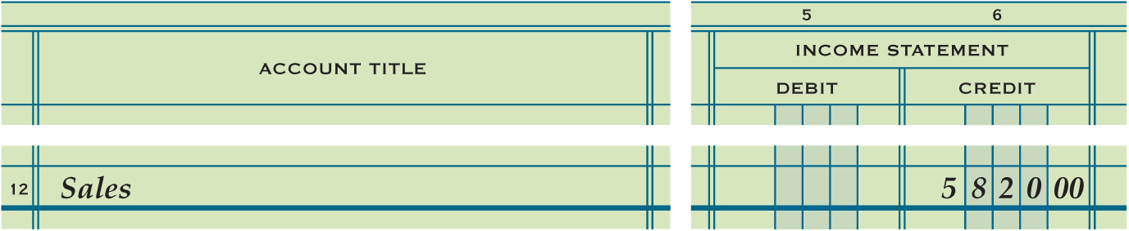
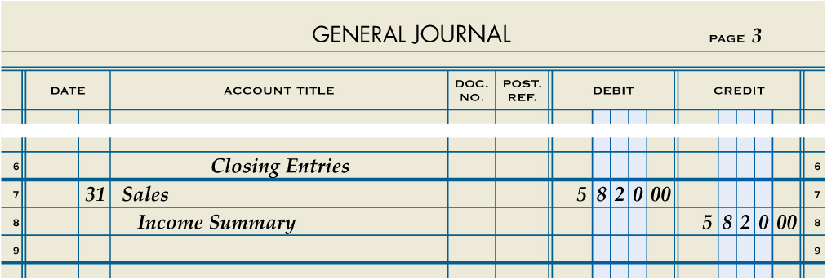
Closing Entry for an Income Statement Account with a Credit Balance
Lesson 8-1
LO1
Sales
Closing 5,820.00
Bal. 5,820.00
(New Bal. 0.00)
Step #1
Income Summary
Closing (revenue) 5,820.00
(Debit to close)
3
Debit
Heading
1
Date
2
4
Credit

Slide 6
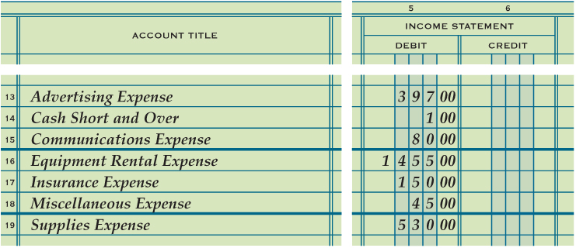
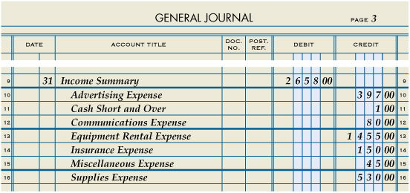
Closing Entry for Income Statement Accounts with Debit Balances
Lesson 8-1
LO1
Step #2
(Credit to close)
Debit Amount
Income Summary
Date
Credit

Slide 7
Income Summary – Net Income
Income Summary
$5,280.00 (Closing Sales)
$2,658.00 (Closing Expenses)
$3,162.00 (Balance)
Net Income

Slide 8
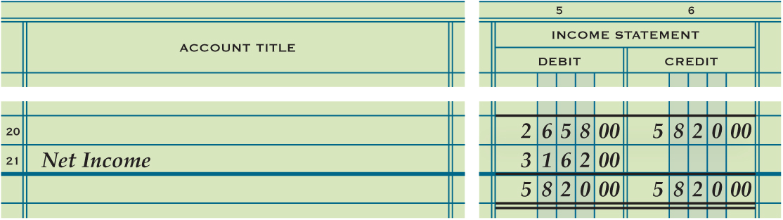
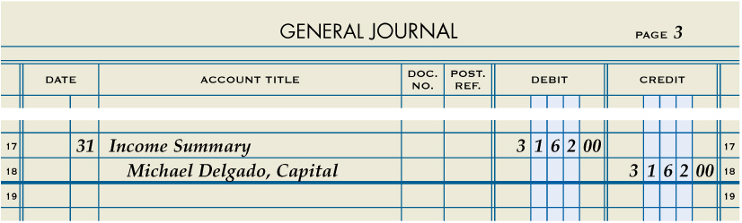
Closing Entry to Record Net Income or Loss and Close the Income Summary Account
Lesson 8-1
LO1
Step #3
(Capital: credit to record net income)
(Income Summary: debit to close)
2
Debit
Date
1
3
Credit

Slide 9
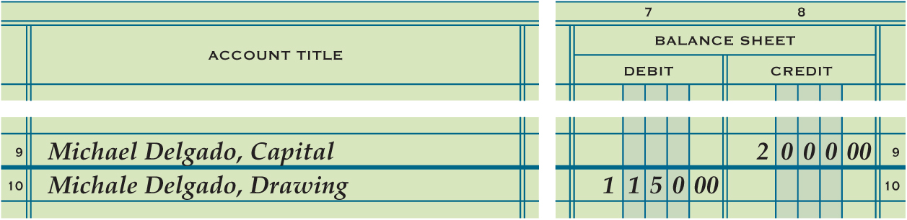
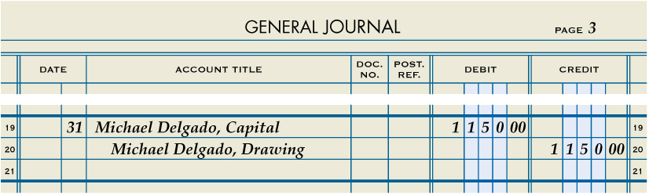
Closing Entry for the Owner’s Drawing Account
Lesson 8-1
LO1
Step #4
(Credit to close)
Date
1
2
Debit
3
Credit

Slide 10
Income Summary – Net Loss (Example)
Income Summary
$5,280.00 (Closing Sales)
$6,658.00 (Closing Expenses)
$1,378.00 (Balance)
Net Loss

Slide 11
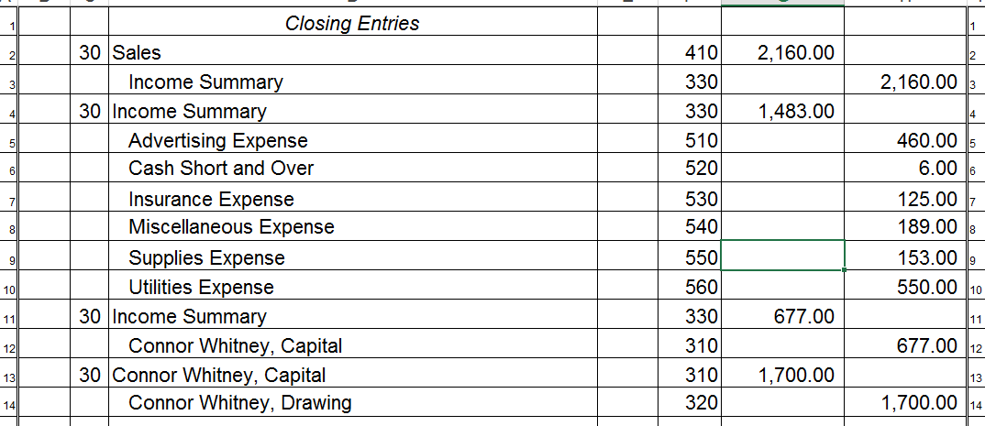
Closing Entry Example
** Notice Sales (2,160) is greater than Expenses (1,483) resulting in Net Income (677) **
#1
#2
#3
#4
** Income Summary is closed into the Capital Account (Increases Owner’s Equity) **
Owner’s Equity is increased with Net Income

Slide 12

Lesson 8-1 Audit Your Understanding
Lesson 8-1
1. What do the ending balances of permanent accounts for one fiscal period represent at the beginning of the next fiscal period?
ANSWER
Beginning balances

Slide 13
Lesson 8-1 Audit Your Understanding
Lesson 8-1
2. What do the balances of temporary accounts show?
ANSWER
Changes in the owner’s capital account for a single fiscal period

Slide 14
Lesson 8-1 Audit Your Understanding
Lesson 8-1
3. List the four closing entries.
ANSWER
1. An entry to close income statement accounts with credit balances.
2. An entry to close income statement accounts with debit balances.
3. An entry to record net income or net loss and close the Income Summary account.
4. An entry to close the owner’s drawing account.

Slide 15
Work Together 8-1 On You Own 8-1
Work Together
8-1 thru 8-2 (Excel)
Modeled
On Your Own
8-1 thru 8-2 (Excel)
Complete

Slide 16

Learning Objective
LO2 Prepare a post-closing trial balance.
© 2014 Cengage Learning. All Rights Reserved.

Slide 17
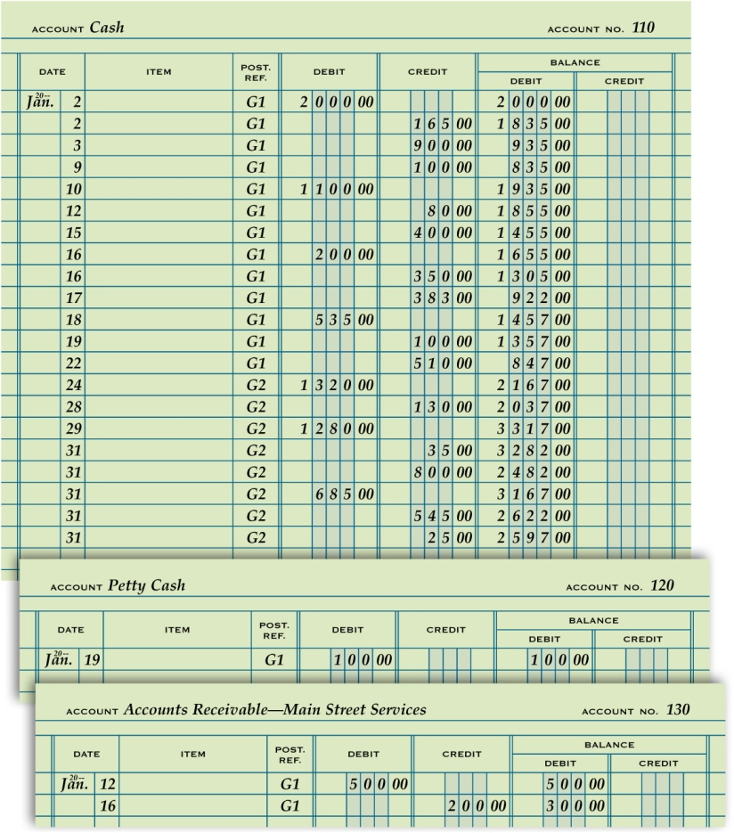
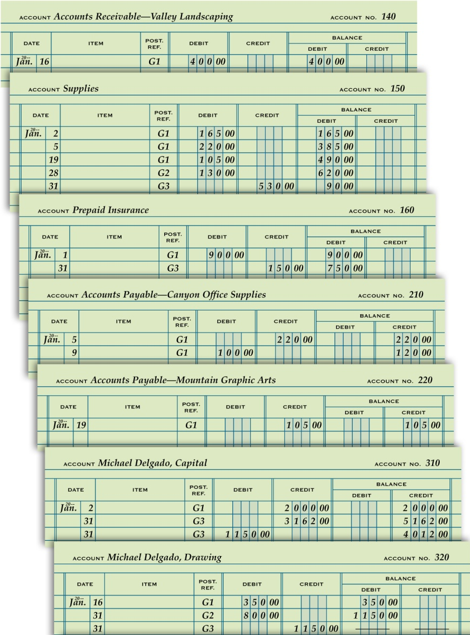
General Ledger Accounts after Closing Entries Are Posted
Lesson 8-2
LO2

Slide 18

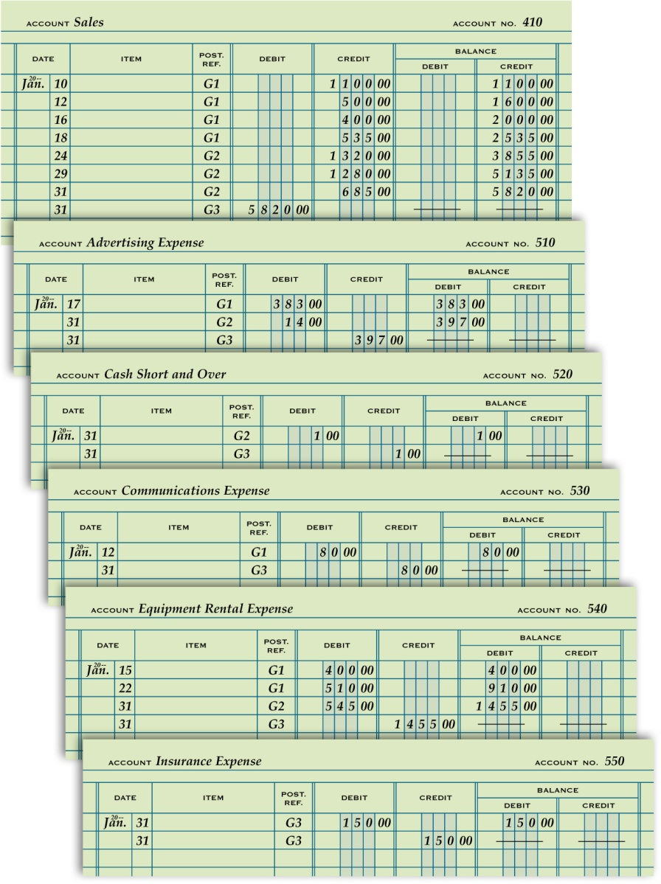

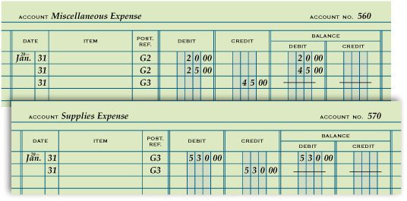
General Ledger Accounts after Closing Entries Are Posted
Lesson 8-2
LO2

Slide 19
Post-Closing Trial Balance
Lesson 8-2
LO2
A trial balance prepared after the closing entries are posted is called a post-closing trial balance.

Slide 20
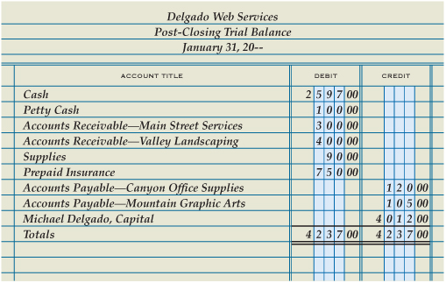
Post-Closing Trial Balance
Lesson 8-2
LO2
Heading
1
Account Titles
Account Balances
2
3
4
Single Rule
Totals
6
Compare Totals
5
Double Rule
8
7
Record Totals

Slide 21
Accounting Cycle for a Service Business
Lesson 8-2
LO2
The series of accounting activities included in recording financial information for a fiscal period is called an accounting cycle.

Slide 22
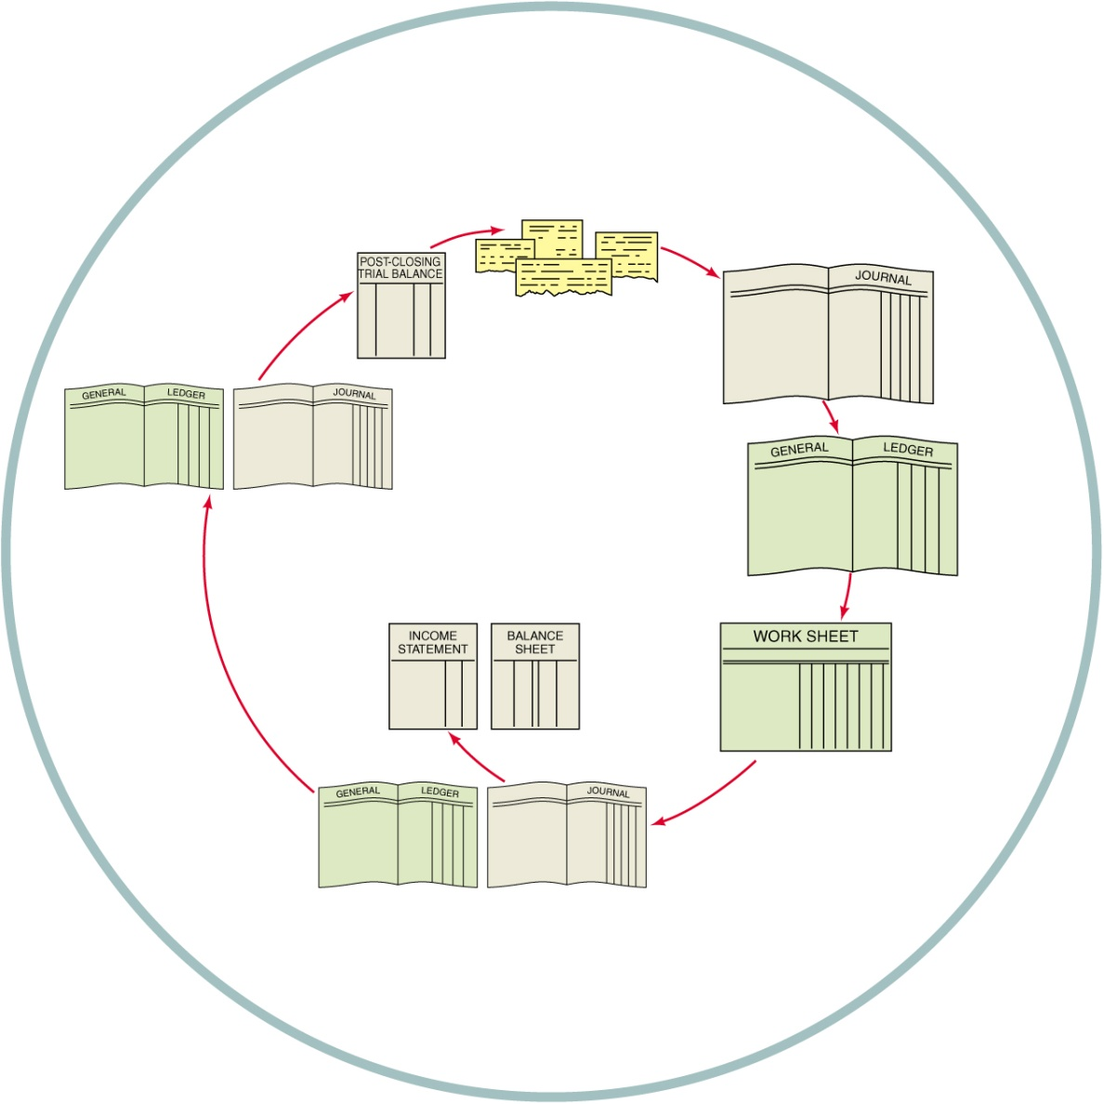
Accounting Cycle for a Service Business
Lesson 8-2
LO2
1. Analyze transactions
1
2. Journalize
2
8
3. Post
4. Prepare work sheet
5. Journalize and post adjusting entries
3
7
6. Prepare financial statements
6
4
7. Journalize and post closing entries
5
8. Prepare post-closing trial balance

Slide 23
Lesson 8-2 Audit Your Understanding
Lesson 8-2
1. Why are lines drawn in both the Balance Debit and Balance Credit columns when an account has a zero balance?
ANSWER
To assure a reader that a balance has not been omitted

Slide 24
Lesson 8-2 Audit Your Understanding
Lesson 8-2
2. Which accounts go on the post-closing trial balance?
ANSWER
Only those with balances (permanent accounts)

Slide 25
Lesson 8-2 Audit Your Understanding
Lesson 8-2
3. Why are temporary accounts omitted from a post-closing trial balance?
ANSWER
Because they are closed and have zero balances

Slide 26
Lesson 8-2 Audit Your Understanding
Lesson 8-2
4. What are the steps in the accounting cycle?
ANSWER
1. Analyze transactions.
2. Journalize.
3. Post.
4. Prepare work sheet.
5. Journalize and post adjusting entries.
6. Prepare financial statements.
7. Journalize and post closing entries.
8. Prepare post-closing trial balance.

Slide 27
Work Together 8-2 On You Own 8-2
Work Together
8-1 thru 8-2 (Excel)
Modeled
On Your Own
8-1 thru 8-2 (Excel)
Complete

Slide 28
Application Problems
8-1 Application Problem
Self-Correcting Excel
8-2 Application Problem
Excel

Slide 29
Application Problems
8 Mastery Problem
Peachtree
8 Challenge Problem
Peachtree

Slide 30
Unit 8 Assessment
Unit 8 Review (ExamView)
90 % or Greater
5 Point Bonus on Unit 1 Concept Quiz (20% Bonus)
Unit 8 Part 1 Quiz (ExamView)
Concepts – 25 Questions (25 Points)
Unit 8 Part 2 Quiz (Excel)
Skills (30 Points)

